Slide 1
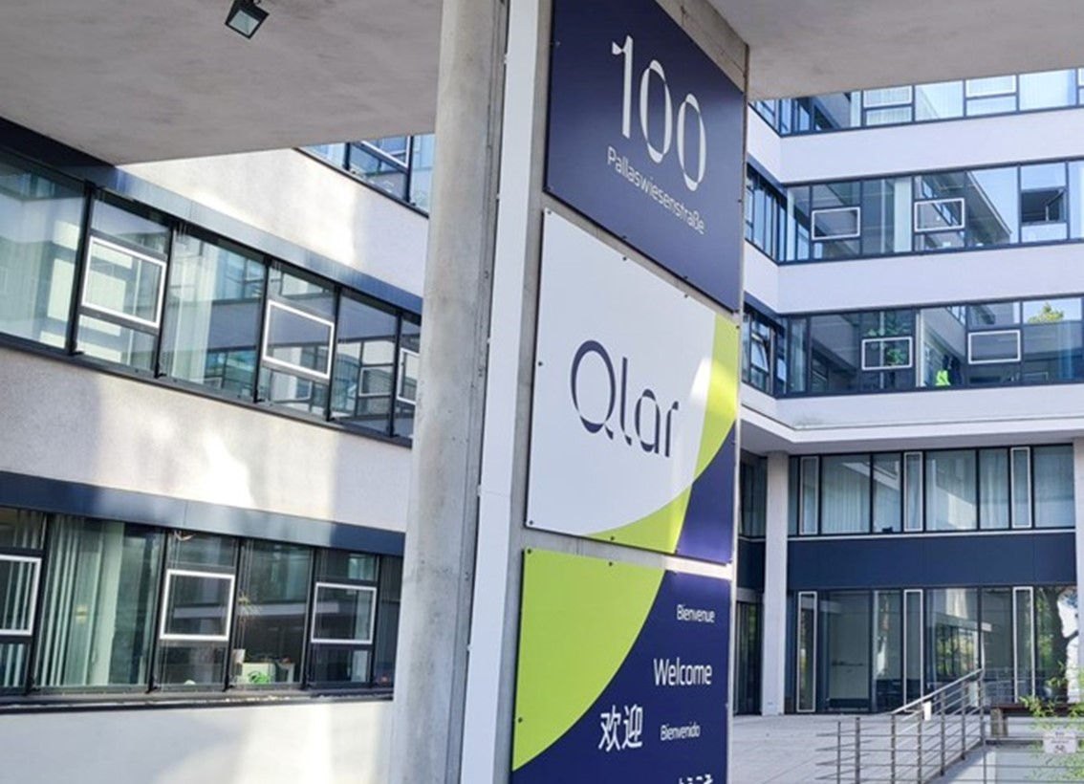




Slide 2

Industry
Mechanical engineering and plant engineering
Products and services
Weighing and conveying
Location
Darmstadt, Germany
Enterprise size
1000 – 2500 employees
Website
www.qlar.com

Slide 3

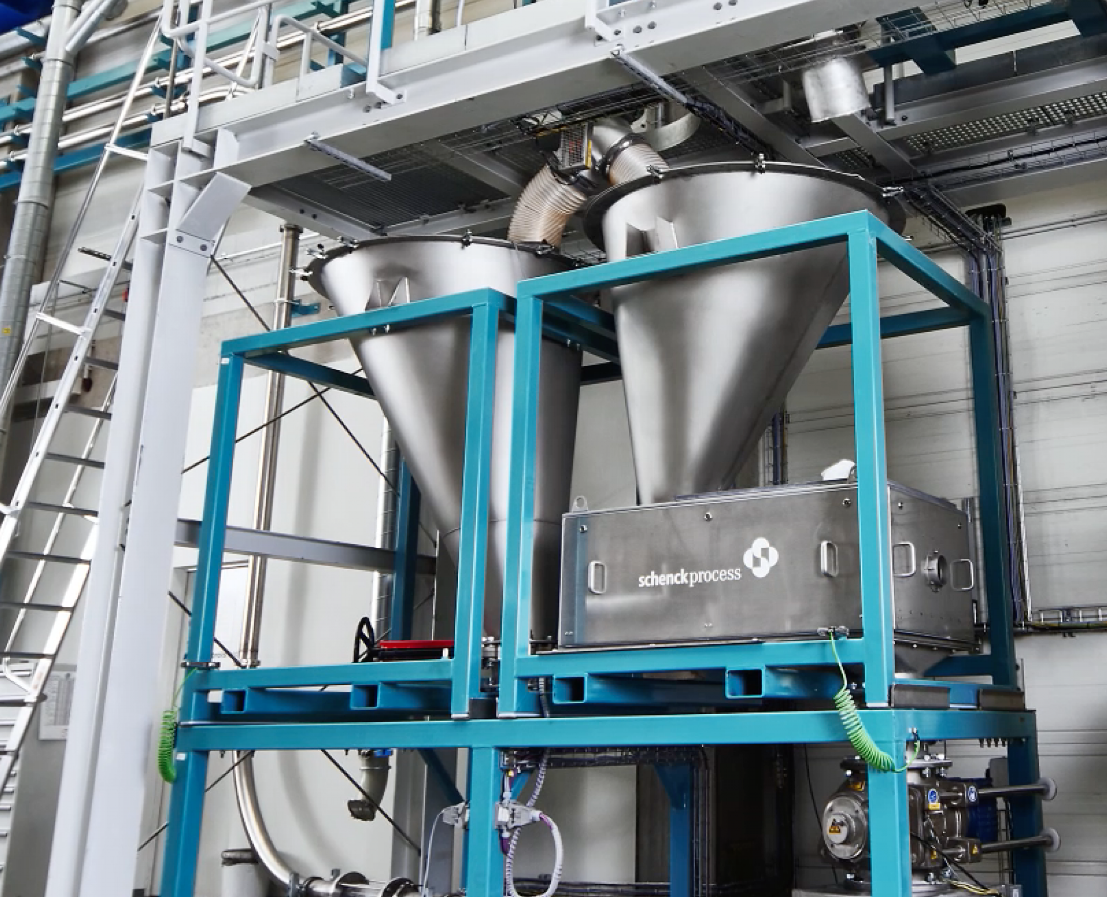





End-to-end PLM processes and Engineer-to-Order processes
The challenges
Complex products and solutions
Fragmented system landscape
Lack of process integration in the process
Engineer-to-Order | ETO complicating
cross-departmental collaboration
Lack of integrated document management
causing decoupled data storage
High administrative expenditures for
data management
Notes:
Document management with SAP Engineering Control Center | SAP ECTR
Process management with SAP Product and Process Governance by BDF | SAP PPG

Slide 4




New PLM concept as a process booster based on SAP S/4HANA
The solution | End-to-end Engineer-to-Order process in the cloud
Efficient data model for the control and automation of processes
Company-wide availability of product data accelerating the ETO process
SAP PPG
+
Automation for document management ensures secure and redundancy-free storage and usage of documents
Linking of processes: from planning, engineering, quality assurance, up to manufacturing and distribution
Notes:
Also on the document level, SAP PPG meets the challenges of storage and ensures the redundancy-free and secure storage so that documents can be used at all locations.

Slide 5





Consolidated and optimized processes for all locations
The results
More customer focus thanks to seamless interaction and shorter lead times
More time for
more demanding tasks
Increased innovation capacity
Reduced administrative
expenditures for data management
More productivity thanks to consolidated and optimized processes

Slide 6
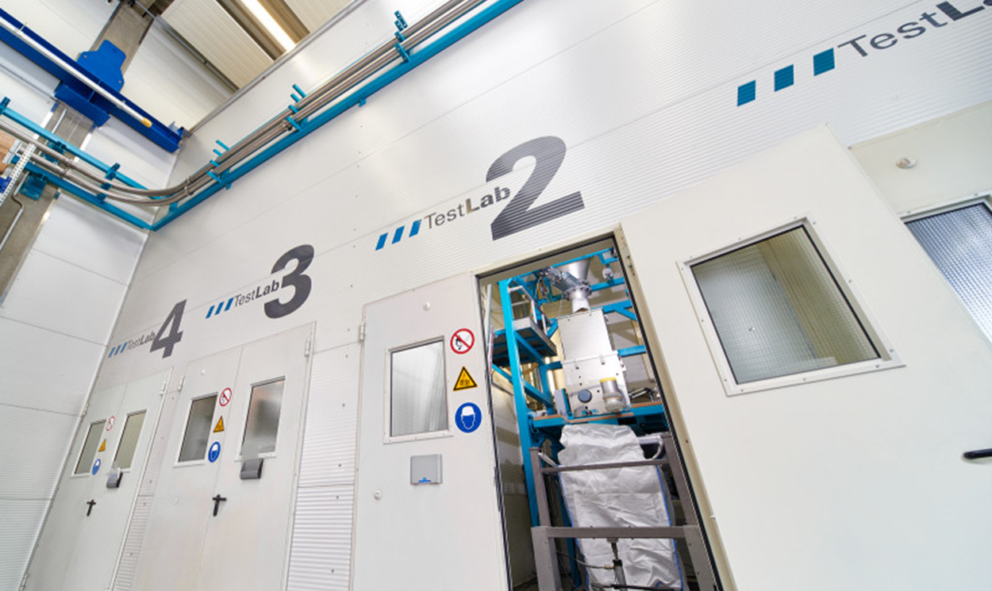
Project milestones
Proof of concept,
definition of subprojects
Subproject 1: PLM / PDM in SAP
Subproject 2: Global Engineering
Model factory as test environment
Wave 2: Subproject
Global Engineering
Optimization of processes in global engineering
Wave 1: Subproject
PLM / PDM in SAP
Implementation of SAP ECTR
with CAD integrations, document management
Implementation
SAP S/4HANA
SAP ECTR
SAP PPG
First Mover
Establishment of ETO process at locations in GER, GB, and CZ

Slide 7
Project realization
About Cideon
Cideon consults and supports companies in the optimization of their product development processes – from concept design and engineering
to manufacturing and service. With their inventive solutions, Cideon enables a consistent data flow throughout the entire process chains and makes data accessible company-wide and also economically usable.
That way, Cideon customers can realize the full potential of digitalization for themselves
and for their customers. With over 310 employees at 13 locations in Germany and Austria, Cideon is part of the Friedhelm Loh Group that celebrates international success in over 12 production sites and over
90 subsidiaries worldwide.
Learn more here:
https://www.cideon.com/ and https://friedhelm-loh-group.com/en/
About BDF EXPERTS
BDF provides EXPERTS for SAP consulting and software development in
Product Lifecycle Management, Supply Chain Management, Maintenance & Service, and Corporate Finance & Treasury based on
SAP S/4HANA and SAP ERP. We consult for middle-sized enterprises to global corporations in Germany, Austria, and Switzerland. As a team of digitalization experts, we digitize and optimize our customers' data and processes.
With our SAP product, SAP PPG by BDF, we support the digital business processes from product development to product service. With the BDF Cash Position Cockpit (BDF CPC), we optimize
the Financial Supply Chain. This way, together we get the most out of
your SAP world.
Learn more here: https://bdfexperts.de/en#home

